Slide 1
REQUIREMENTS ENGINEERING

Slide 2

Modelling – UML and Use Case Models

Slide 3

Modelling Recap
A Model is a representation of a system in some form. A is a Model of B if A can be used to answer questions about B
Couple of important goals of Modelling
Providing an Understanding (existing) System
Analyzing and Validating the requirements in terms of visible requirements within the problem
Communicating the requirements in terms of who, what and interpreting it in the same way
Discussed different kinds of Models
Structural Models and Behavioral models
Notes:
Take example of electrical circuits

Slide 4
What is UML
Unified Modeling Language
Language to express different types of models
Language defines
Syntax – Symbols and rules for using them
Semantics – What these symbols represent
UML can be used to
Visualize (Graphical Notation)
Specify (Complete and Unambiguous)
Construct (Code Generation)
Document (Design, Architecture, etc.)
the artifacts of software-intensive systems
Notes:
Take example of electrical circuits

Slide 5

Conceptual model of UML
Diagrams : Graphical representation of set of elements, often rendered as a set of connected graph of vertices (things) and arcs (relationships)
It’s a projection into the system
Relationship ties together the things or abstractions
There are four different kinds of relationships
Things are abstractions in the model.
There are four kinds of things or abstraction
UML
Use case is a description of set of sequences of actions that a system performs that yields an observable result of value to a particular actor in other words a functional requirement
Its used to structure the behavior. Its
realized using collaboration. Depicted as an ellipse with solid lines
Building
blocks
Rules
Common
mechanisms
name, scope, visibility
Diagrams
UML is made up of three conceptual elements. They are
Building blocks which make up the UML
Rules that dictate how these building blocks can be put together
Common mechanisms that apply through out UML
Things
Relations
Class
Object
Use case
Sequence
Collaboration
Statechart
Activity
Component
Deployment
Dependency
Association
Generalization
Realization
Structural
Behavioral
Grouping
Annotate
Class
Interface
Active class
Component
Node
Interaction
State machine
Package
Note
Use Case Diagram
Shows actors, use cases, and relationships
Use case
Collaboration
Notes:
Things are abstractions in the model
Relations deal with how these abstractions tie together
Group interesting collections of things

Slide 6
Conceptual model of UML
Diagrams
Graphical representation of set of elements, often rendered as a set of connected graph of vertices (things) and arcs (relationships)
It’s a projection into the system
Component Diagram
Shows deployable components, including interfaces, ports, and internal structure
State Diagram
Shows states, transitions, events, and activities depicting the dynamic view of internal object states
Activity Diagram
Shows processes, including flow of control and data
UML
Class Diagram
Shows classes, interfaces, relationships
Most common – address static view
Object Diagram
Shows objects (instances)
Use Case Diagram
Shows actors, use cases, and relationships
Collaboration Diagram
Interaction diagram similar to sequence diagram, but a spatial view, using numbering to indicate time order
Sequence Diagram
Shows interactions between objects as a time-ordered view
Deployment Diagram
Shows the configuration of run-time processing nodes and the components that are deployed on them
Building
blocks
Rules
Common
mechanisms
name, scope, visibility
Things
Relations
Diagrams
Class
Object
Use case
Sequence
Collaboration
Statechart
Activity
Component
Deployment
Dependency
Association
Generalization
Realization
Structural
Behavioral
Grouping
Annotate
Class
Interface
Active class
Component
Node
Interaction
State machine
Package
Note
Use case
Collaboration
Notes:
Things are abstractions in the model
Relations deal with how these abstractions tie together
Group interesting collections of things

Slide 7
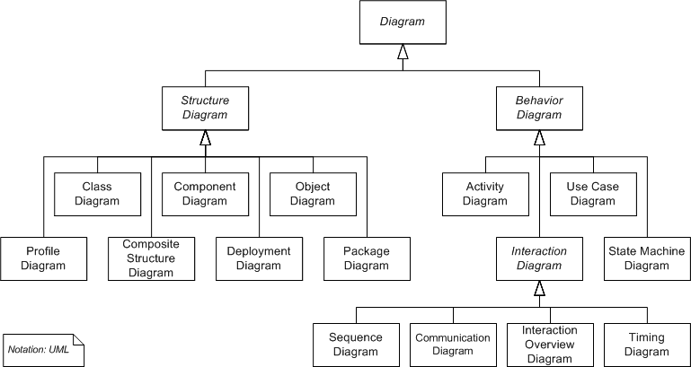
UML Diagrams
Structural things are the nouns of the UML models. Represent elements that are either conceptual or physical
These are dynamic parts of the UML models. Represent behavior over time and space. Typically verbs of the model

Slide 8
UML Models and associated diagram types
Static or Structural diagrams:
What must be in the system
Class
Component
Deployment
Composite structure
Object
Package
Dynamic or Behavioral diagrams:
What must happen in the system
Activity
State machine
Use case
Interaction diagram (kind of Dynamic diagram):
[emphasize the flow of control and data among the things in the system]
Communication
Sequence
Timing

Slide 9
Conceptual model of UML (repeat .. for readability purpose)
UML
Building
blocks
Rules
Common
mechanisms
name, scope, visibility
Things
Relations
Diagrams
Class
Object
Use case
Sequence
Collaboration
Statechart
Activity
Component
Deployment
Dependency
Association
Generalization
Realization
Structural
Behavioral
Grouping
Annotate
Class
Interface
Active class
Component
Node
Interaction
State machine
Package
Note
Use case
Collaboration
Notes:
Things are abstractions in the model
Relations deal with how these abstractions tie together
Group interesting collections of things

Slide 10
UML Diagrams (repeat contents for the Animated Slide)
Use Case Diagram
Shows actors, use cases, and relationships
Class Diagram
Shows classes, interfaces, relationships
Most common – address static view
Object Diagram
Shows objects (instances)
Component Diagram
Shows deployable components, including interfaces, ports, and internal structure
Activity Diagram
Shows processes, including flow of control and data

Slide 11
UML Diagrams… (continued) repeated contents for the Animated Slide
State Diagram
Shows states, transitions, events, and activities depicting the dynamic view of internal object states
Sequence Diagram
Shows interactions between objects as a time-ordered view
Collaboration Diagram
Similar to sequence diagram, but a spatial view, using numbering to indicate time order
Deployment Diagram
Shows the configuration of run-time processing nodes and the components that are deployed on them

Slide 12
Using Use Case Diagrams
Use case diagrams are used to visualize, specify, construct, and document the (intended) behavior of the system, during requirements capture and analysis.
Provide a way for developers, domain experts and end-users to Communicate.
Serve as basis for testing.
Use case diagrams contain use cases, actors, and their relationships.

Slide 13
Use Case
Use cases specify the desired behavior.
A use case is
a description of a set of sequences of actions a system performs to yield an observable result of value to an actor.
includes variants
Named as verb.
Each sequence represent an interaction of actors with the system.
name

Slide 14
Actors
An actor represents a set of roles that users of use case play when interacting with these use cases.
Actors can be human or automated systems.
Actor is someone interacting with use case (system function). Named by noun.
Actors are entities which require help from the system to perform their task or are needed to execute the system’s functions.
Actors are not part of the system.
An Actor triggers use case
Actor has responsibility toward the system (inputs), and have expectations from the system (outputs).
name
<< actor >>
X Authorization System

Slide 15
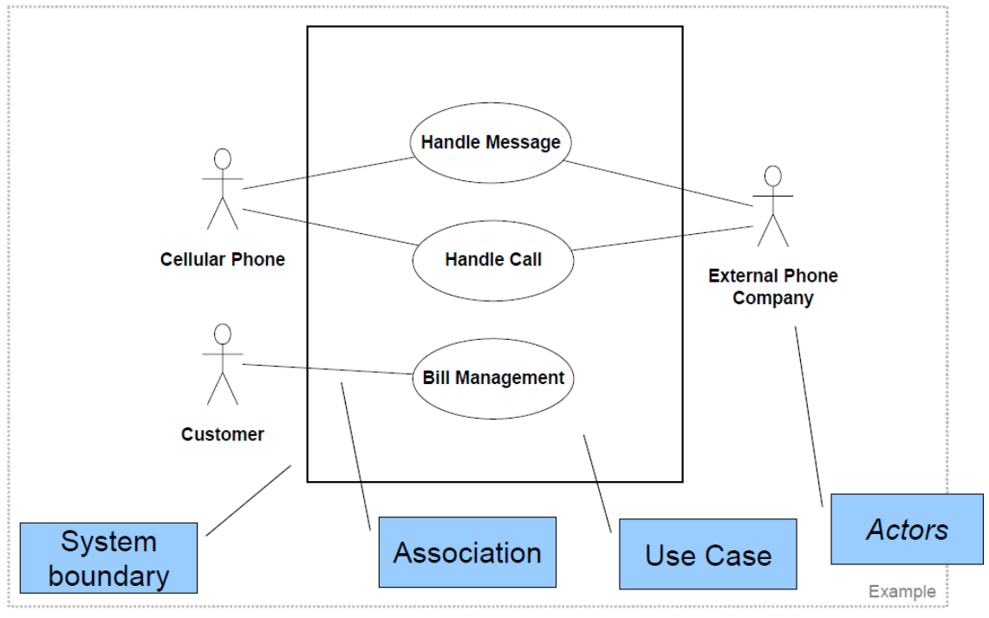
Example of Use Case Diagram

Slide 16
Example
registration
updating
grades
student
faculty
output
generating

Slide 17
Relationships between Use Cases
1. Generalization - use cases that are specialized versions of other use cases.
2. Include - use cases that are included as parts of other use cases. Enable to factor common behavior.
3. Extend - use cases that extend the behavior of other core use cases. Enable to factor variants.

Slide 18
1. Generalization
The child use case inherits the behavior and meaning of the
parent use case.
The child may add to or override the behavior of its parent.
Share the same relationship to the actor
parent
child

Slide 19
More about Generalization
registration
non-graduate
registration
graduate
registration

Slide 20
Generalization as a Relationships between Actors
student
graduate
student
non-graduate
student

Slide 21
2. Include
The base use case explicitly incorporates the behavior of another use case at a location specified in the base.
The included use case never stands alone. It only occurs as a part of some larger base that includes it.
<<include>>
base
included

Slide 22
More about Include
Enables to avoid describing the same flow of events several times by putting the common behavior in a use case of its own.
Process Sale request
Process rental request
<<include>>
<<include>>
Handle Credit Card Payment

Slide 23
3. Extend
The base use case implicitly incorporates the behavior of another use case at certain points called extension points.
The base use case may stand alone, but under certain conditions its behavior may be extended by the behavior of another use case.
base
<<extend>>
extending

Slide 24
More about Extend
Enables to model optional behavior or branching under conditions.
<<extend>>
Exam-grade appeal
Exam copy request

Slide 25
Relationships between Use Cases and Actors
Actors may be connected to use cases by associations, indicating that the actor and the use case communicate with one another using messages.
updating
grades
faculty

Slide 26
Example
place
conference call
place
phone call
<<extend>>
cellular
network
receive
additional call
receive
phone call
<<extend>>
use
scheduler
user
Cellular Telephone

Slide 27
Use case diagram of a restaurant
Use Case

Slide 28
Formal template for representing of a Use Case – Use case Specification
Name (Must start with a verb)
Summary
Actors
Pre-conditions
Conditions that must exist before the use case is executed
Description
Textual description (may include steps to execute) and typically is the primary functionality
Exceptions
These are paths which will need to handle exceptions which could be all to provide handling of things which are not provide you with a primary functionality including things like power failure
Alternate Flows
Handles the other functionality paths for the summary these could be some in the exceptions too
Post-conditions
Conditions that must exist after the use case is executed
Notes:
It is important to add details for an use case as graphical representation is not enough.

Slide 29
Example (Internet Banking)
Name: Transfer Funds
Summary/Overview : Transfer funds from one account to another
Actor: Customer
Pre-conditions
Source account must have sufficient funds
Description
Customer identifies the accounts from which and to which funds have to be transferred, enters the amount to be transferred, and confirms the transaction
Exceptions
Cancel, Insufficient funds, Cannot identify destination account
Needs to handle ..say power failure
Alternate Flows
Handles all the exception paths
Post-conditions
Funds transferred and account balances updated

Slide 30
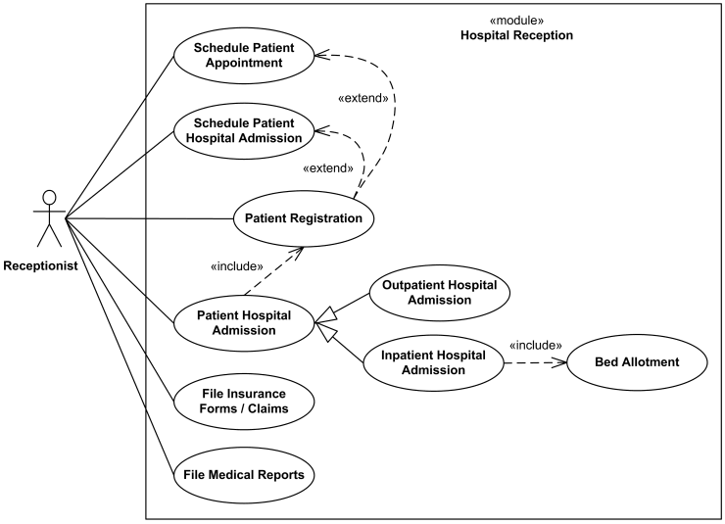

Slide 31
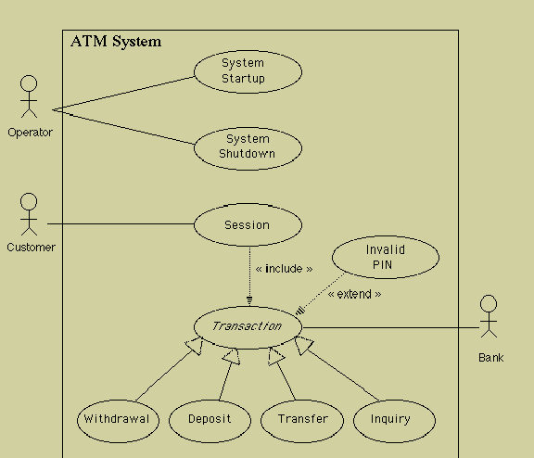

Slide 32
How to create Use Case diagram
List main system functions (use cases) in a column
Draw ovals around the function labels
Draw system boundary
Draw actors and connect them with use cases
Specify include and extend relationships between use cases

Slide 33
Use Case Description
Each use case may include all or part of the following:
Title or Reference Name - meaningful name of the UC
Author/Date - the author of the UC and its creation date
Modification/Date - last modification to the UC and its date
Purpose - specifies the goal to be achieved by the UC
Overview - short description of the use cases processes
Cross References - requirements references
Actors - agents which initiate or participate in the UC
Pre Conditions - must be true to allow the execution of the UC
Post Conditions - will be set when the use use completes its execution normally
Normal flow of events - regular flow of activities of the UC
Alternative flow of events - other flow of activities of the UC
Exceptional flow of events - unusual situations
Implementation issues - possible foreseen problems in the implementation of the UC
Each use case may include all or part of the following:
Title or Reference Name - meaningful name of the UC
Author/Date - the author and creation date
Modification/Date - last modification and its date
Purpose - specifies the goal to be achieved
Overview - short description of the processes
Cross References - requirements references
Actors - agents participating
Pre Conditions - must be true to allow execution
Post Conditions - will be set when completes normally
Normal flow of events - regular flow of activities
Alternative flow of events - other flow of activities
Exceptional flow of events - unusual situations
Implementation issues - foreseen implementation problems

Slide 34
Example- Money Withdraw
Actors: Customer
Pre Condition:
The ATM must be in a state ready to accept transactions
The ATM must have at least some cash on hand that it can dispense
The ATM must have enough paper to print a receipt for at least one transaction
Post Condition:
The current amount of cash in the user account is the amount before the withdraw minus the withdraw amount
A receipt was printed on the withdraw amount
The withdraw transaction was audit in the System log file

Slide 35
Example- Money Withdraw (cont.)
Typical Course of events:
Actor Actions | System Actions
1. Begins when a Customer arrives at ATM
2. Customer inserts a Credit card into ATM | 3. System verifies the customer ID and status
5. Customer chooses “Withdraw” operation | 4. System asks for an operation type
7. Customer enters the cash amount | 6. System asks for the withdraw amount
 | 8. System checks if withdraw amount is legal
 | 9. System dispenses the cash
 | 10. System deduces the withdraw amount from account
 | 11. System prints a receipt
13. Customer takes the cash and the receipt | 12. System ejects the cash card

Slide 36
Example- Money Withdraw (cont.)
Alternative flow of events:
Step 3: Customer authorization failed. Display an error message, cancel the transaction and eject the card.
Step 8: Customer has insufficient funds in its account. Display an error message, and go to step 6.
Step 8: Customer exceeds its legal amount. Display an error message, and go to step 6.
Exceptional flow of events:
Power failure in the process of the transaction before step 9, cancel the transaction and eject the card

Slide 37
Example- Money Withdraw (cont.)
One method to identify use cases is actor-based:
Identify the actors related to a system or organization.
For each actor, identify the processes they initiate or participate in.
A second method to identify use cases is event-based:
Identify the external events that a system must respond to.
Relate the events to actors and use cases.
The following questions may be used to help identify the use cases for a system:
What are tasks of each actor ?
Will any actor create, store, change, remove, or read information in the system ?
What use cases will create, store, change, remove, or read this information ?
Will any actor need to inform the system about sudden, external changes ?
Does any actor need to be informed about certain occurrences in the system ?
Can all functional requirements be performed by the use cases ?

